Slide 1
Code Contracts in dev11 (and dev12)
Manuel Fahndrich, Mike Barnett, Francesco Logozzo, Brian Grunkemeyer, Justin van Patten, Wolfram Schulte
7/7/2010

Slide 2
Overview
Contracts are #1 feature requested for Java
We are ahead in .NET: let’s provide tools in the box
Code Contracts support agile development
TDD with Contracts
Amplify Unit and Continuous testing
Disseminates API information more effectively
Clean progression dev10 → dev11 → dev12
Authoring → Runtime Checking → Static Checking
Feedback from early adopters

Slide 3


Scenario: Matt used TDD with Contracts
Write failing tests first, then make tests succeed
Use contracts to:
Generalize expected outcomes in code (Ensures, Invariants)
Control assumptions (Requires)
Extra benefits
Test outcome not hidden in testing code → increased testing on all runs
Automatic documentation (XML, Sandcastle)
Test code
Code under test
Notes:
Matt has to write a TrimSuffix method. He uses TDD and writes a set of small tests. At the same time, he also thinks about the generalized outcome of the method and writes a Contract.Ensures to specify that the result should not end in the suffix.
As he is testing with various inputs he refines the assumptions of the method and documents them using Requires. Using Pex, Matt discovers a way to violate the post-condition that his tests did not include, namely when he has to remove repeated suffixes.
Matt’s projects use XML doc files and automated documentation generation. On the next build, the documentation automatically includes detailed contracts on how to use the new TrimSuffix method.

Slide 4
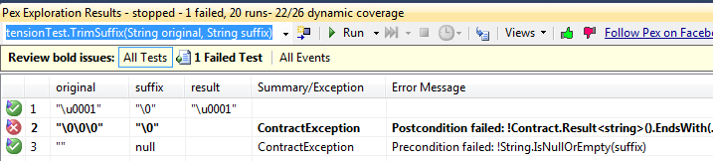
Matt runs Pex to see if his tests cover all corner cases.
Thanks to the Contract.Ensures Matt wrote, Pex discovers that the code does not work for repeated suffixes. After fixing his code and adding that test case, Matt checks in.

Slide 5
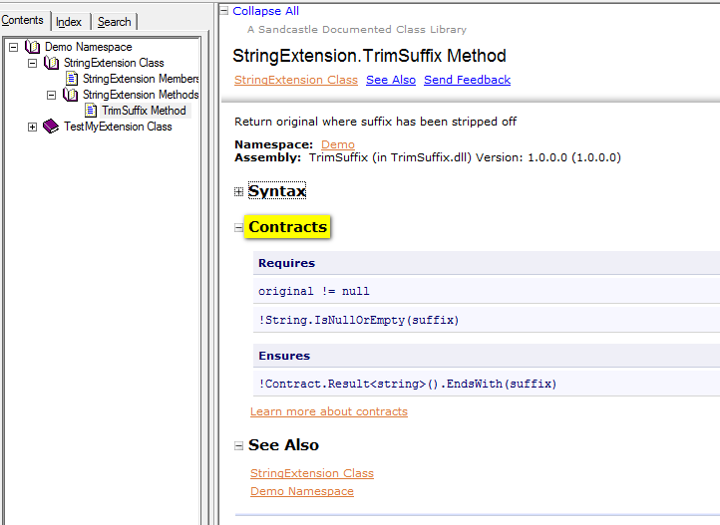
Matt’s team uses automated documentation generation. The TrimSuffix contracts show up on the next doc build.

Slide 6
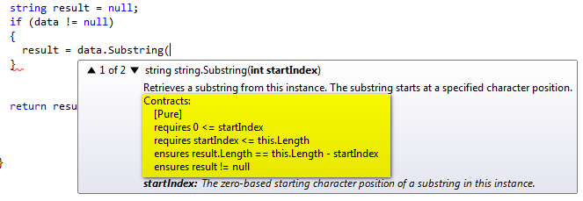
Scenario: Discover rules while Coding
Coders using existing library annotated with Contracts (e.g., BCL)
Show rules during coding where and when needed
Intellisense quick info, hover, and metadata
Notes:
Discover requirements when calling methods without having to go to the documentation first

Slide 7
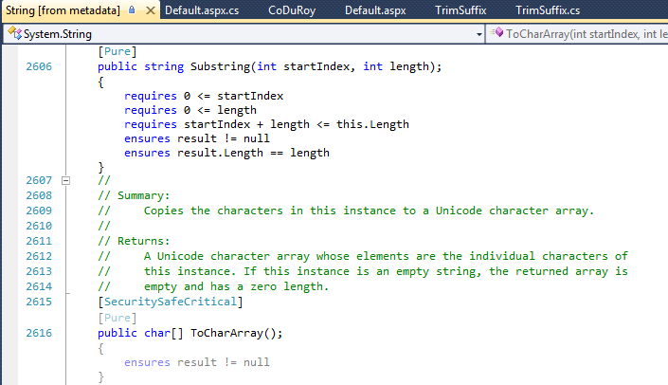
F12: Go to definition [from metadata]

Slide 8
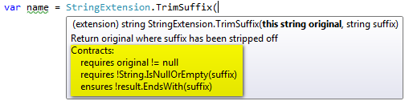
Scenario: Disseminate Usage Rules
Just like 3rd party APIs with Contracts, programmers also discover contracts in their own solutions
Speed up dissemination of information within and across teams
Intellisense quick info and hover
Notes:
Phil is using the new TrimSuffix method that Matt just checked in. As he types the call, intellisense shows him the proper requirements of the parameters. This way, Phil discovers right away that the method won’t work if the suffix is empty. Phil thus fixes his code to avoid that corner case before even running his first test.

Slide 9
Scenario: Pinpointing Error Causes
Jean is a new team member tasked to refactor some ASP.Net and Silverlight code that she’s not familiar with.
Some test fails after her change, but she does not understand why the outcome isn’t the expected one.
Fortunately, the team has been using CodeContracts liberally and Matt shows her how to enable runtime checking.
Running the tests in Debug mode, Jean hits an object invariant violation at the end of a method she modified.
Notes:
Jean is the new member on the team and tasked with maintaining a web site using ASP.NET with C# code behind and Silverlight in the browser. Jean has to perform some important refactoring but she is not sure whether her changes are permissible. One of the regression tests now fails, but it is not clear why the result is not what is expected by the test. Fortunately, the team has been using contracts liberally in the Silverlight app and in the Code behind part and Matt shows Jean how to enable the runtime checking of contracts in both the Silverlight projects and the ASP.NET web server projects. Running the tests in Debug mode with contracts instrumented into the product some tests now fail with an object invariant violation at the end of a method Jean modified. Looking at the original invariant, Jean sees exactly what condition she failed to maintain. The failing invariant pinpointed by CodeContracts led Jean to the source of the error and helped her figure out how to fix the problem, whereas the failing test outcome at the end of the test run left her clueless.

Slide 10
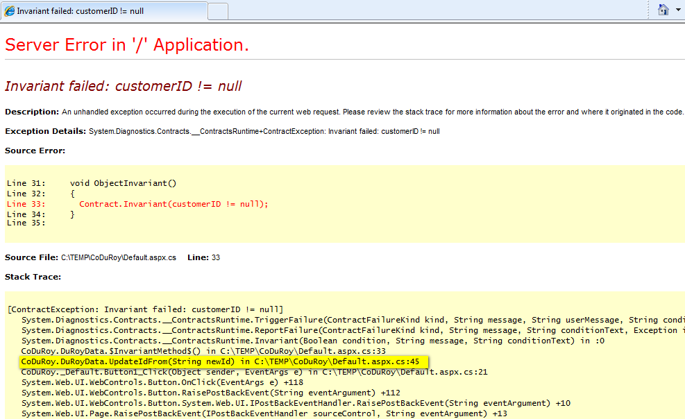
Notes:
Jean is the new member on the team and tasked with maintaining a web site using ASP.NET with C# code behind and Silverlight in the browser. Jean has to perform some important refactoring but she is not sure whether her changes are permissible. One of the regression tests now fails, but it is not clear why the result is not what is expected by the test. Fortunately, the team has been using contracts liberally in the Silverlight app and in the Code behind part and Matt shows Jean how to enable the runtime checking of contracts in both the Silverlight projects and the ASP.NET web server projects. Running the tests in Debug mode with contracts instrumented into the product some tests now fail with an object invariant violation at the end of a method Jean modified. Looking at the original invariant, Jean sees exactly what condition she failed to maintain. The failing invariant pinpointed by CodeContracts led Jean to the source of the error and helped her figure out how to fix the problem, whereas the failing test outcome at the end of the test run left her clueless.

Slide 11
Looking at the original invariant, Jean sees exactly what condition she failed to maintain.
The failing invariant pinpointed by CodeContracts led Jean to the source of the error and helped her figure out how to fix the problem, whereas the failing test outcome at the end of the test run left her clueless.

Slide 12
Dev12 Scenario: Code Review Analysis
Jean is ready to submit a feature change.
VisualStudio presents her with a ranked list of warnings newly introduced, changed, or fixed by her changeset.
Still new to the project Jean is not sure how to address the warnings, so she submits her changeset for review to Matt and Phil.
Matt and Phil see the list of affected warnings along with the changeset.
Matt suggests extra preconditions and a few changes to avoid potential null-dereferences among the warnings.

Slide 13
The code review system performs an update of the warning list based on Matt’s suggested preconditions and other changes.
As a result, a call-site is found that violates the new preconditions.
Matt files a bug against that piece of code.
Phil investigates the remaining warnings and classifies them as benign or not likely.
After changing the code and submitting the update for the review, no new unclassified warnings are reported by the system and everyone signs off on the review.

Slide 14
Vision for CodeContract integration
dev10
Contract Authoring
dev11
Runtime Contract Checking
dev12
Static Contract Checking
Support in all SKUs
Upgrade-driver to premium SKUs
Increase general usage, familiarity
Individual opt-in
TDD, Testing, Debugging, and documentation scenarios
Code review and Quality gate scenarios

Slide 15
User Feedback
Just over a year on DevLabs
About 20,000 downloads (less than 10 versions), currently the busiest DevLabs forum.
User Survey
Given a set of options for where the CLR BCL team should invest, largest number (24%) chose Code Contracts. Next largest number was 15%.
Over 3,000 hours of time spent adding contracts, around 9K bugs reported found.
Fairly consistent numbers: the heaviest users saved between 1 and 6 hours of debugging for every hour spent adding contracts. And that is just the initial benefit.
Huge sentiment for putting the tools “into the box” and wanting performance improvements.

Slide 16

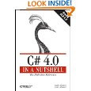

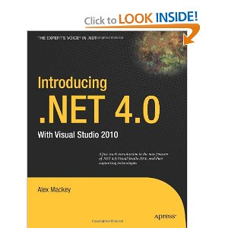
Word is Spreading
Books!
Blogs
over 30 external blogs listed on our web site
Kevin Hazzard (http://devjourney.com). Well-respected C# MVP is doing a series on Code Contracts. (8/14)
Channel 9 Videos (way over 100K views)
Two top-rated PDC presentations (2008, 2009).
One representative quote:
At this point, as a supported project or not, I cannot imagine our team coding without it. All issues notwithstanding, Code Contracts has saved us many man hours in just a few short months. With the number of issues it has detected, we were all willing to deal with the performance of a heavy static analysis. – Ken Muse (ecoinsight.com)

Slide 17
The Various Parts
Code Contracts
Authoring of Contracts
Build scripts
Rewriter
Contract Reference Assemblies
Property Pane
Contract XML Docs
Contract Visualization
Static Checker
dev10
dev11
dev12

Slide 18
Work Items
All major parts are implemented.
Need:
Testing and code hardening and bringing up to VS standard.
Improve contract extraction for VB constructors.
Implement some missing functionality in contract visualization.
Performance.
Possibly:
Support F# by handling F# idioms in extractor.
Programming language specific rendering of conditions. (Currently original source language is used.)
Integration with existing reference assemblies.

